Slide 1

Confusion Matrix Metrics Part 5 (When to use Precision, Recall and when to avoid them)
Machine Learning

Slide 2


precision = $\frac{TP}{TP+FP}$
recall = $\frac{TP}{TP+FN}$
Precision and recall come from information retrieval.
Imagine we have 100 documents in our database, out of which 25 contain the results for “f1 score”.
Now when we search for “f1 score”, imagine our algorithm gives us back 30 results, out of which only 15 contain relevant results.
Precision is the ratio of retrieved relevant results and total retrieved results → 15/30 = 0.5
Recall is the ratio of retrieved relevant results and all relevant results → 15/25 = 0.6
One thing we notice is that precision and recall don’t particularly care about true negatives, i.e. the results not useful for the user.

Slide 3
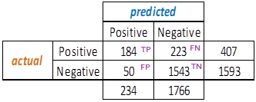


precision = $\frac{TP}{TP+FP}$
recall = $\frac{TP}{TP+FN}$
Churn modeling dataset.
Positive: customer exited bank
But in our case, imagine the bank has decided to offer extra perks to everyone who is predicted to leave the bank, to possibly try and convince them to stay.
Now our mission should be to try and correctly predict every single “positive” person, right? (increase recall, by minimizing FN)
But now due to the precision-recall trade-off, our model wrongly predicts many happy customers to leave, so it’d be an unnecessarily extra cost for the bank to offer perks to already happy customers!
Hence, precision and recall (and consequently F score) are not ideal measures for our case, or in general for any case where a model needs to be good at predicting both classes fairly well.

Slide 4
To summarize:
Avoid Precision, Recall, F-measures when dealing with cases which require predictions of both classes equally well (imagine we are predicting apples and oranges from their images – now we’d ideally want to make a model that predicts both apples and oranges equally well)
Use Precision, Recall, F-measures when dealing with cases which do NOT require predictions of both classes equally well (like information retrieval, i.e. where the number of true negatives does not really matter)

Slide 5
Confusion Matrix Metrics Part 6 (Sensitivity, Specificity, Balanced Accuracy)
Machine Learning

Slide 6
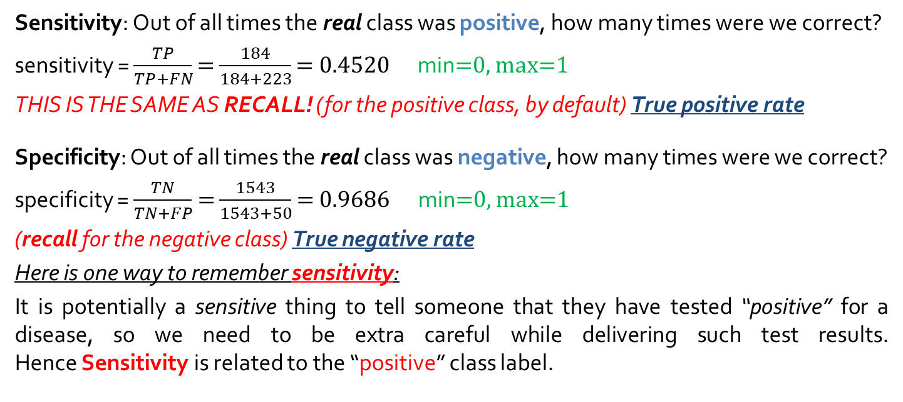
Churn modeling dataset.
Positive: customer exited bank
Sensitivity: Out of all times the real class was positive, how many times were we correct?
sensitivity = $\frac{TP}{TP+FN}$ = $\frac{184}{184+223}$ = 0.4520 min=0, max=1
THIS IS THE SAME AS RECALL! (for the positive class, by default) True positive rate
Specificity: Out of all times the real class was negative, how many times were we correct?
specificity = $\frac{TN}{TN+FP}$= $\frac{1543}{1543+50}$ = 0.9686 min=0, max=1
(recall for the negative class) True negative rate
Here is one way to remember sensitivity:
It is potentially a sensitive thing to tell someone that they have tested “positive” for a disease, so we need to be extra careful while delivering such test results. Hence Sensitivity is related to the “positive” class label.

Slide 7
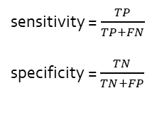
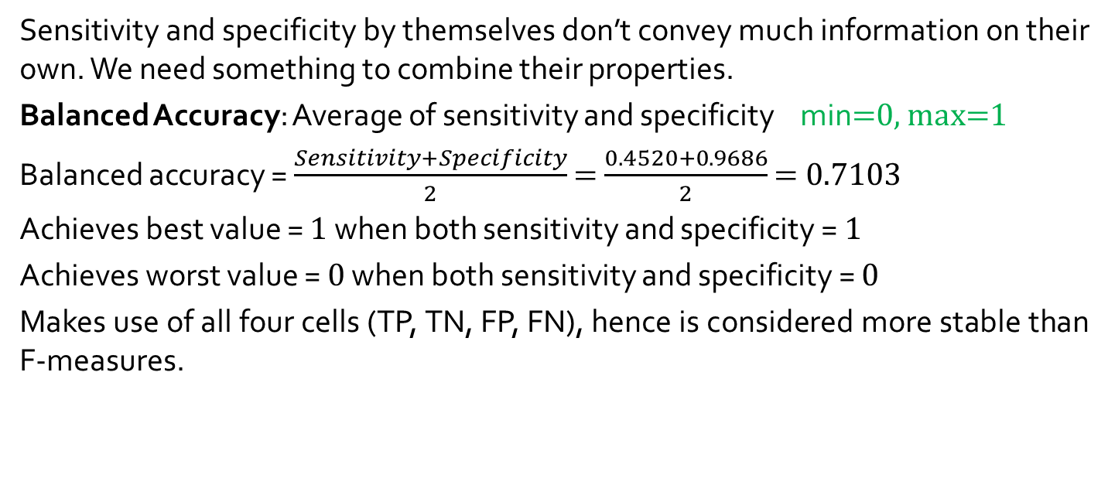


sensitivity = $\frac{TP}{TP+FN}$ specificity = $\frac{TN}{TN+FP}$
precision = $\frac{TP}{TP+FP}$
recall = $\frac{TP}{TP+FN}$
Sensitivity and specificity by themselves don’t convey much information on their own. We need something to combine their properties.
Balanced Accuracy: Average of sensitivity and specificity min=0, max=1
Balanced accuracy = $\frac{Sensitivity+Specificity}{2}$ = $\frac{0.4520+0.9686}{2}$ = 0.7103
Achieves best value = 1 when both sensitivity and specificity = 1
Achieves worst value = 0 when both sensitivity and specificity = 0
Makes use of all four cells (TP, TN, FP, FN), hence is considered more stable than F-measures.

Slide 8
Confusion Matrix Metrics Part 7 (Multi-class Classification)
Machine Learning

Slide 9
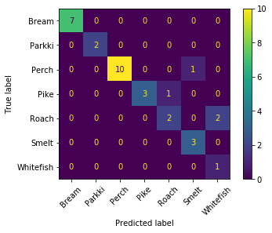
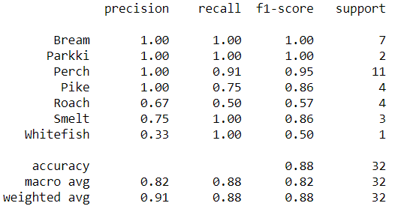


Although we’ve seen only for binary classification, confusion matrix works equally well for multi-class classification.
We’ll look at a fish dataset, classifying fishes into various types.
precision = $\frac{TP}{TP+FP}$
recall = $\frac{TP}{TP+FN}$

